Slide 1
What is a Young Carer?
Young carers are children and young people who help care in families where someone has an illness, a disability, a mental health issue or for someone who has an alcohol or drug problem.
The person they help care for might be a parent, a sibling, a grandparent or other relative, or maybe a friend.

Slide 2
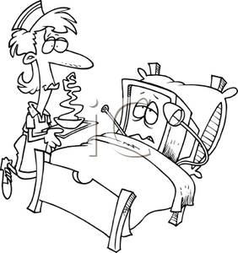
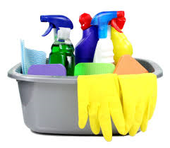
What Does a Young Carer Do?
Personal care
Cooking
Cleaning
Paying Bills
Emotional Support
Shopping
Giving Medication

Slide 3
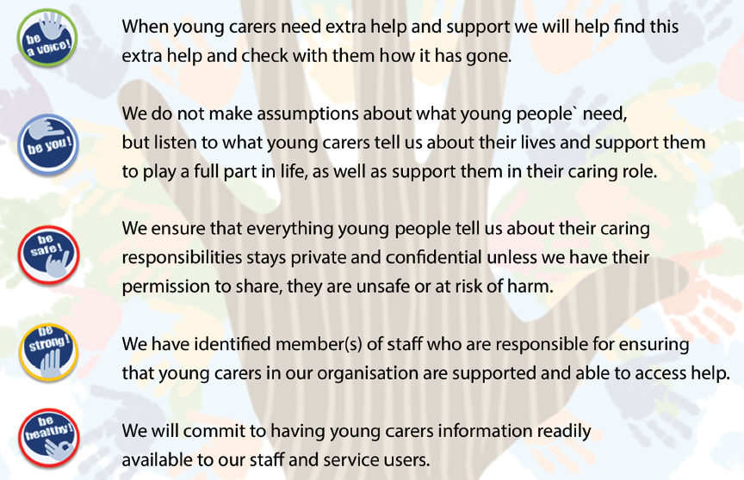

Slide 4
Our Pledge To improve identification and recognition for Young Carers and their Families!

